Slide 1

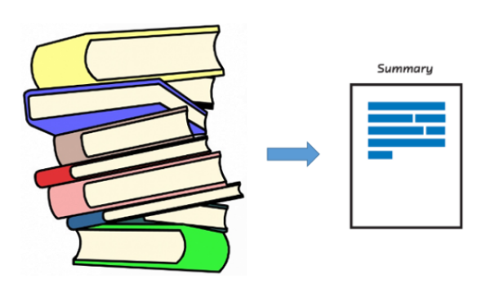
Document Summarization

Slide 2
Document Summarization
Take an information source,
extract content from it,
and
present the most important content to the user
in a condensed form,
in a manner sensitive
to the user’s or
application’s needs.

Slide 3
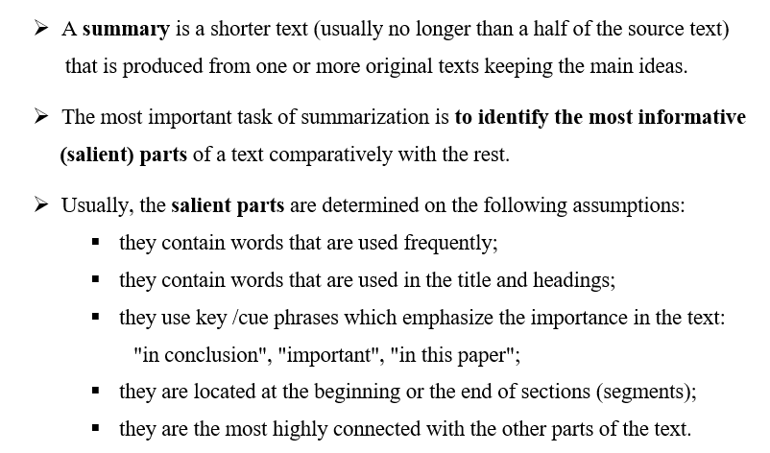
Summary

Slide 4
Automatic summarization
The process by which a computer program creates
a shortened version of text.
Three important aspects characterize research on automatic summarization:
Summaries may be produced from a single document or multiple documents;
Summaries should preserve important information;
Summaries should be short and coherent.

Slide 5
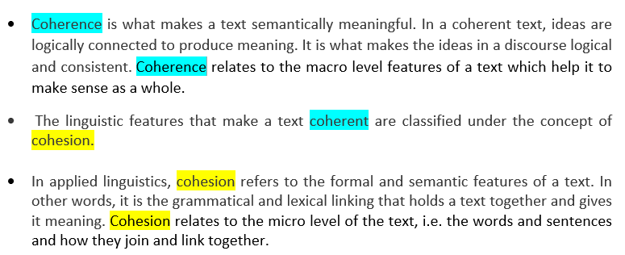
Two main components are important in content writing: coherence and cohesion

Slide 6
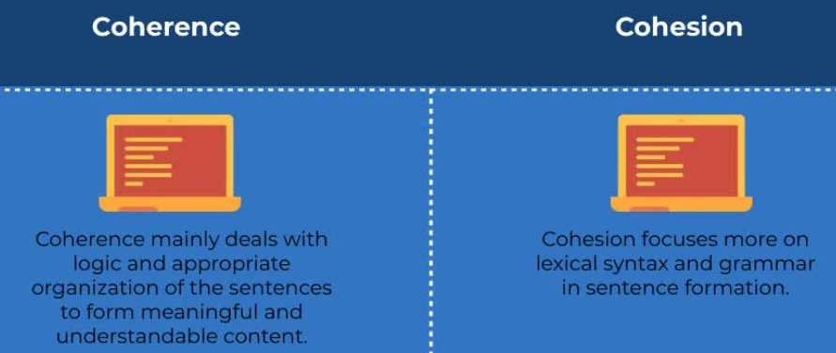
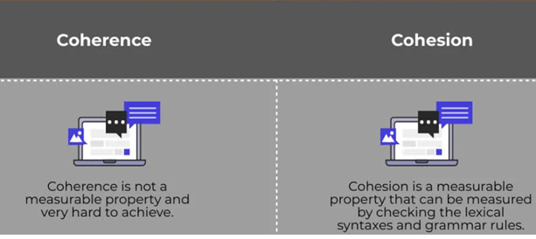

Slide 7
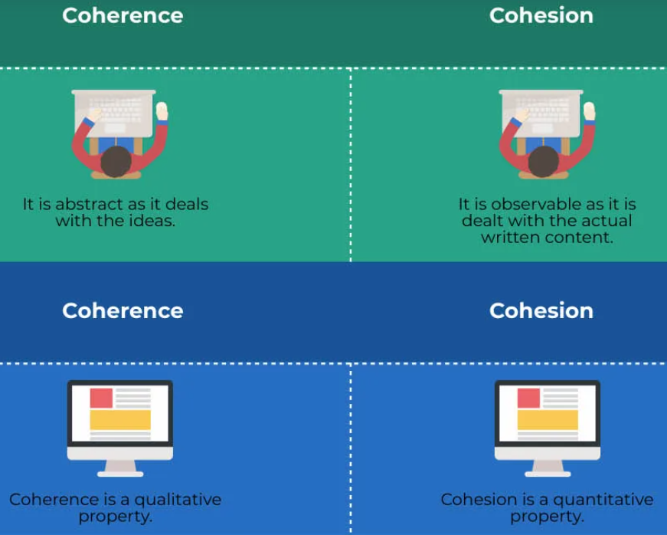

Slide 8
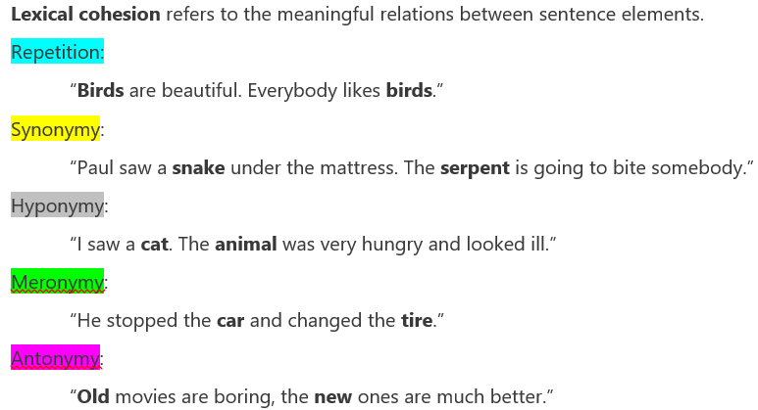
Examples of cohesion

Slide 9
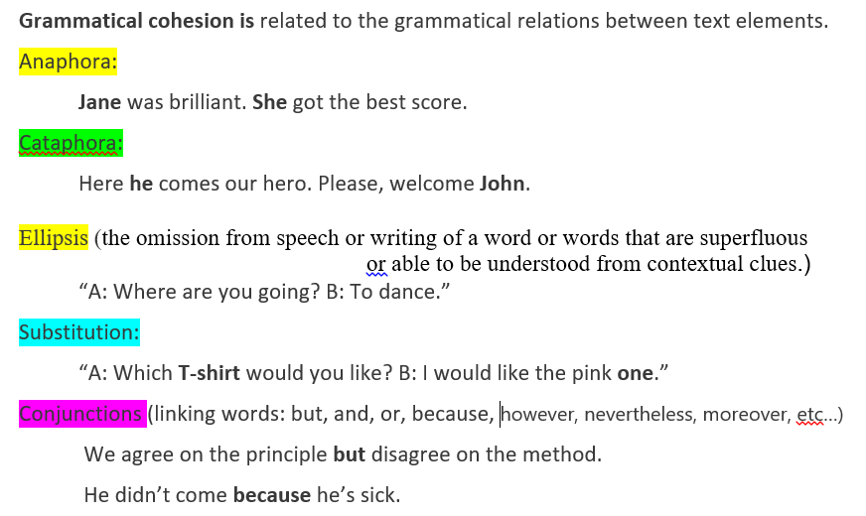
Examples of cohesion

Slide 10
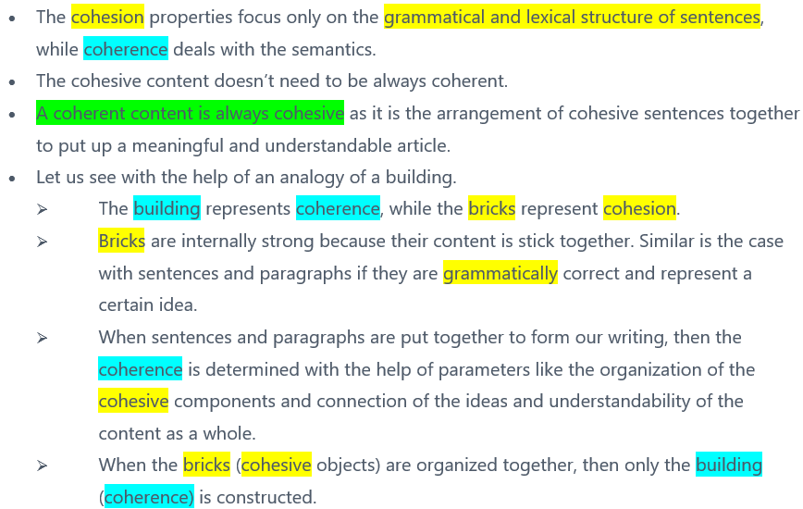
Cohesion and Coherence

Slide 11
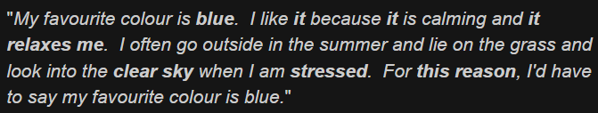
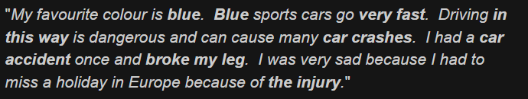

Coherence and Cohesion - examples
Coherent and cohesive
Not coherent but cohesive
Not coherent but cohesive

Slide 12
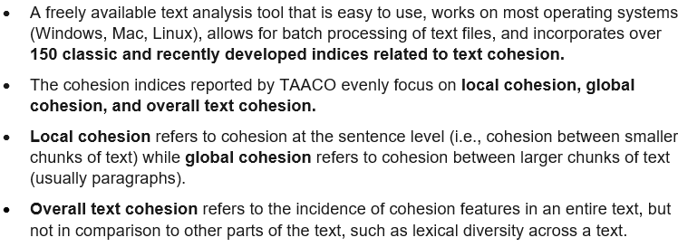
TAACO: Tool for the Automatic analysis of Cohesion
https://www.linguisticanalysistools.org/taaco.html
https://soletlab.asu.edu/taaco/

Slide 13
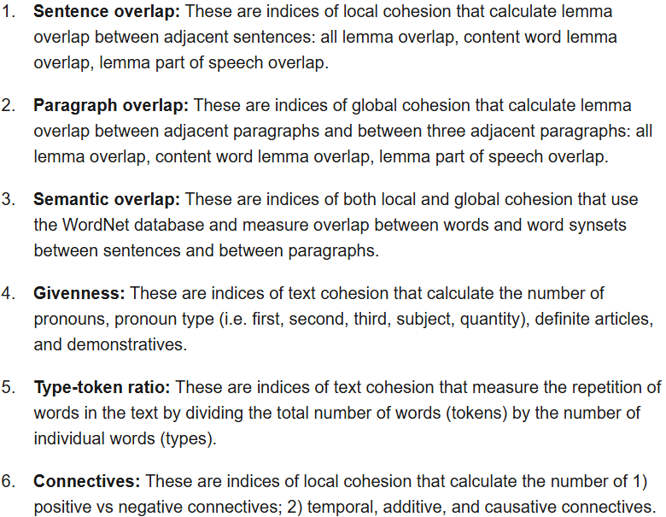
Some Indices reported by TAACO

Slide 14
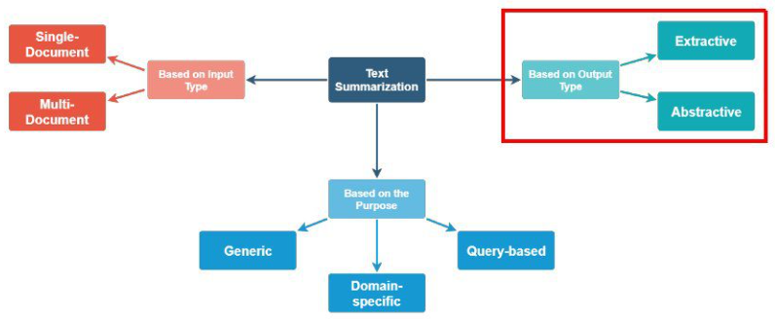
Automated text summarization approaches

Slide 15
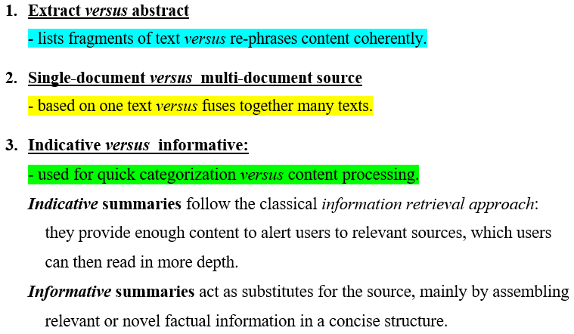
Genres of a summary

Slide 16
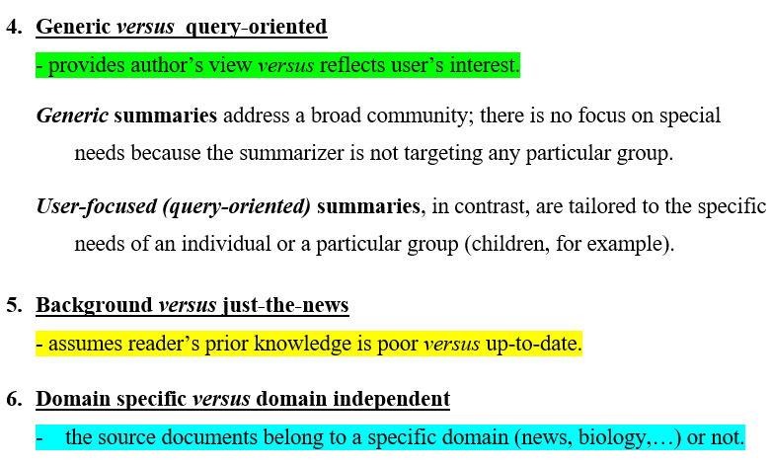
Genres of a summary (contd.)

Slide 17
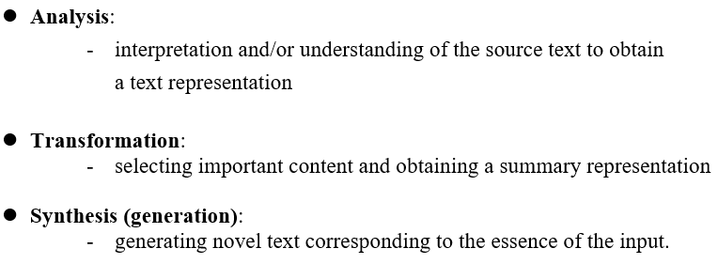
Stages of summarization

Slide 18
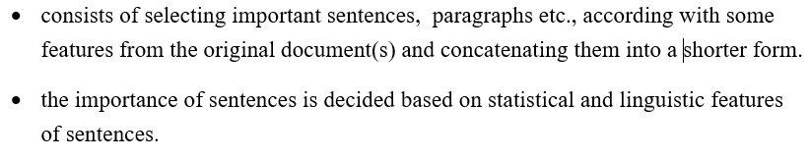
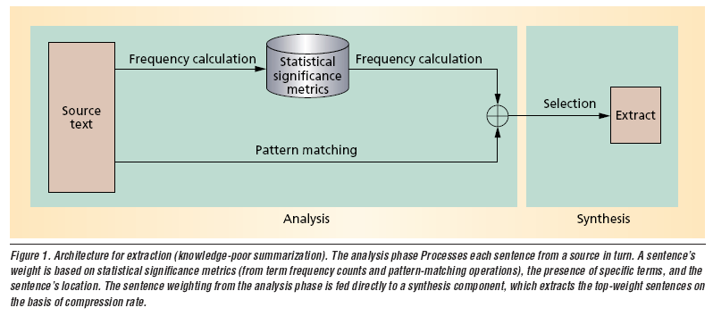
extractive summarization

Slide 19
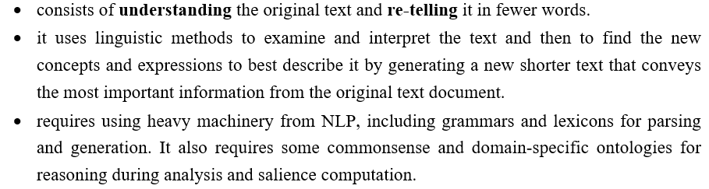
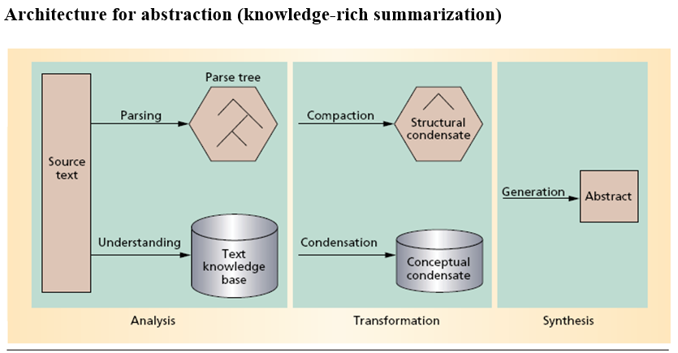
abstractive summarization

Slide 20
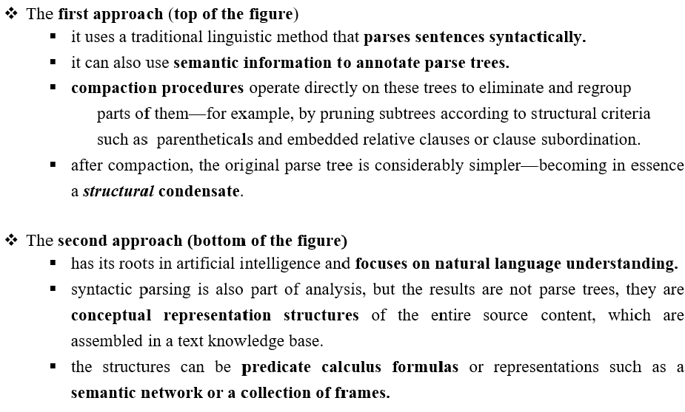
ABSTRACTIVE SUMMARIZATION: analysis phase

Slide 21
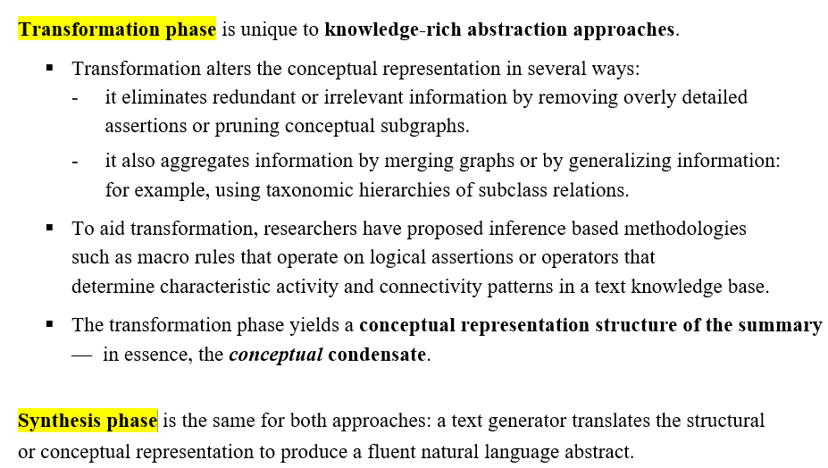
ABSTRACTIVE SUMMARIZATION

Slide 22
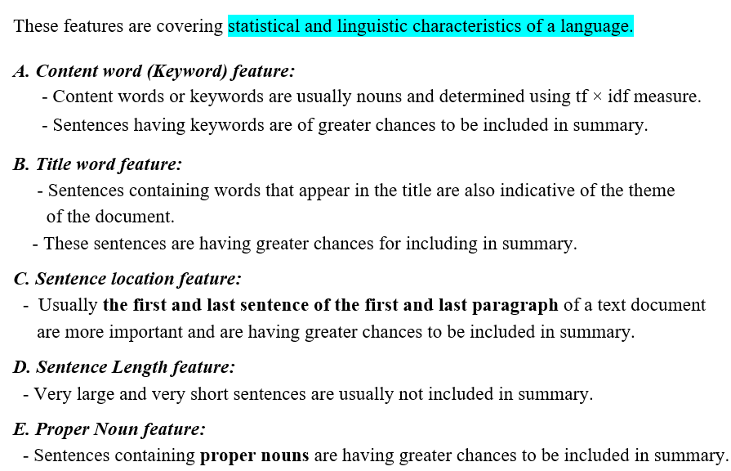
Features for extractive text summarization

Slide 23
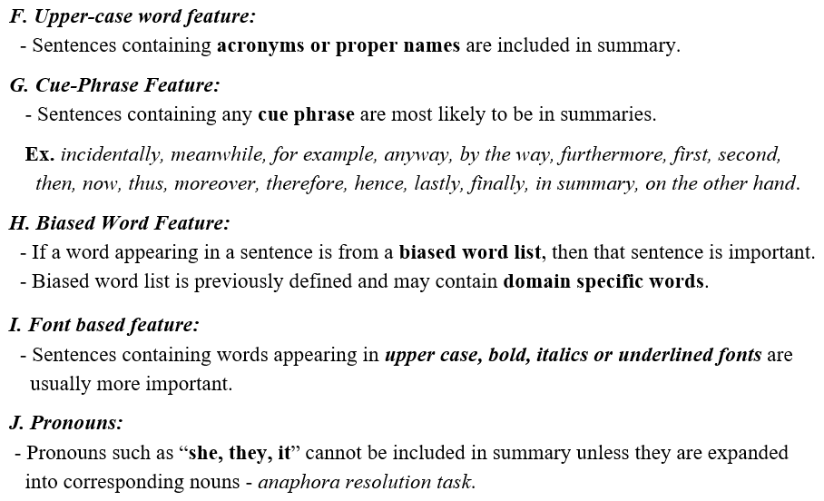
Features for extractive text summarization

Slide 24
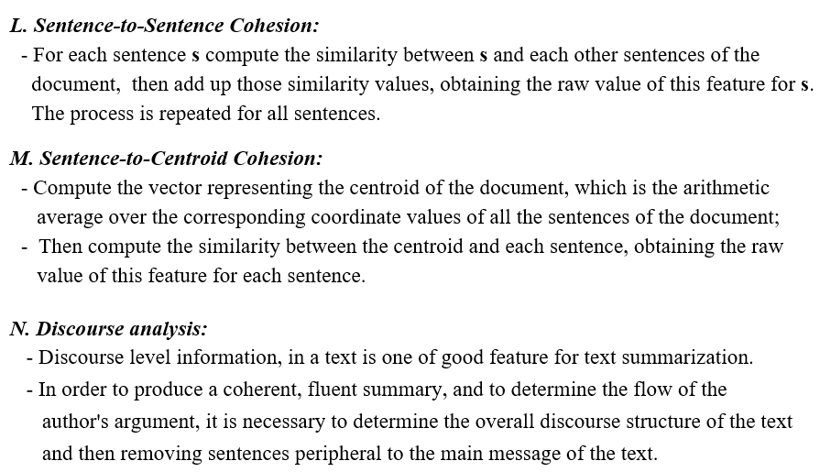
Features for extractive text summarization

Slide 25
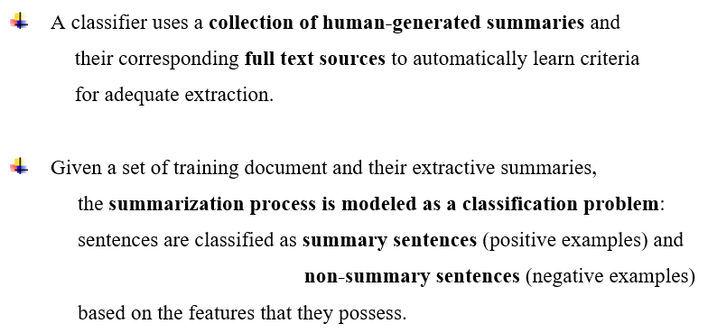
Machine learning approach

Slide 26
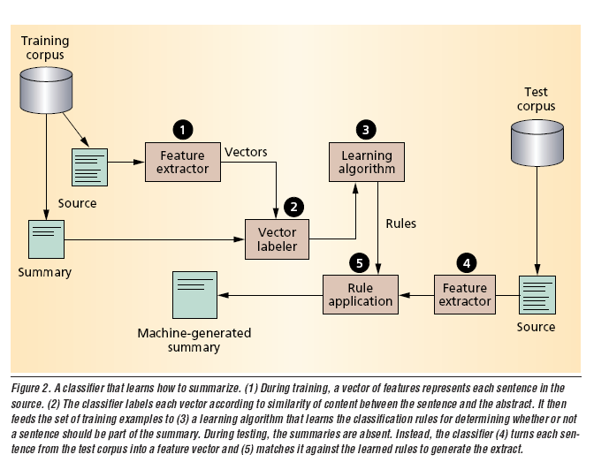
Machine learning approach

Slide 27
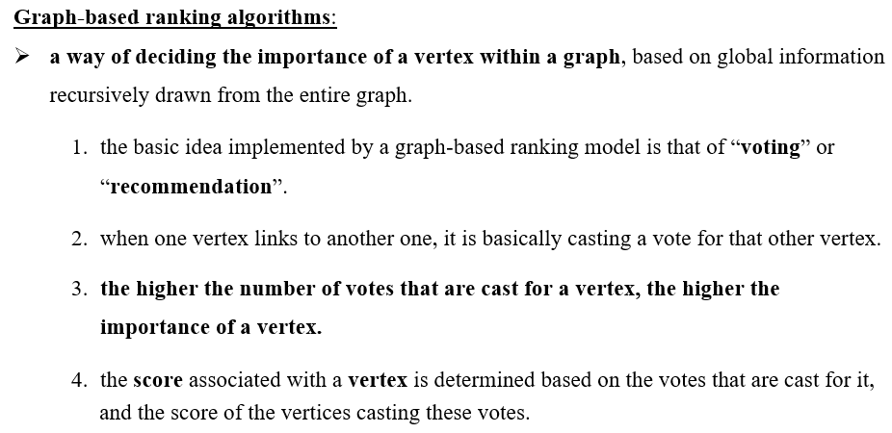
I. Graph-based Ranking Algorithms for Sentence Extraction, Rada Mihalcea, 2004

Slide 28
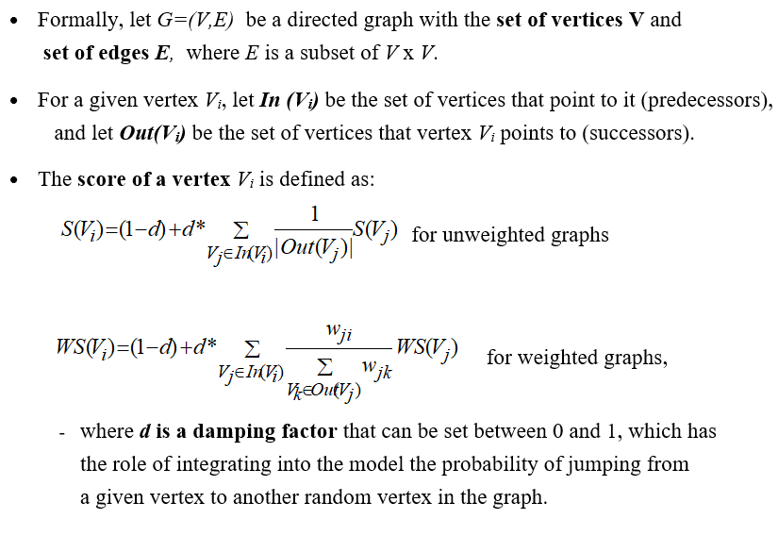
Graph-based Ranking model

Slide 29
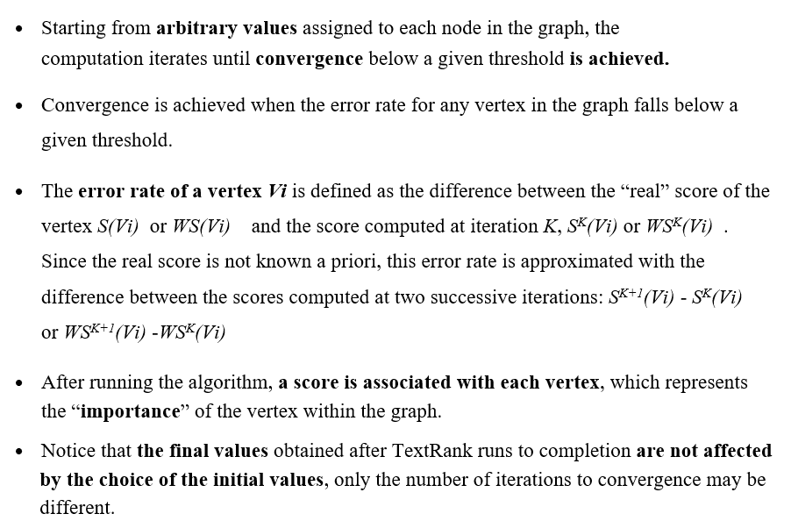
Graph-based Ranking Algorithm

Slide 30
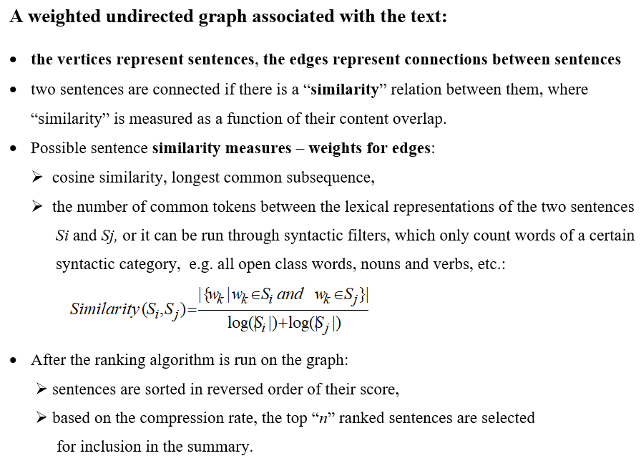
Sentence extraction with TextRank

Slide 31
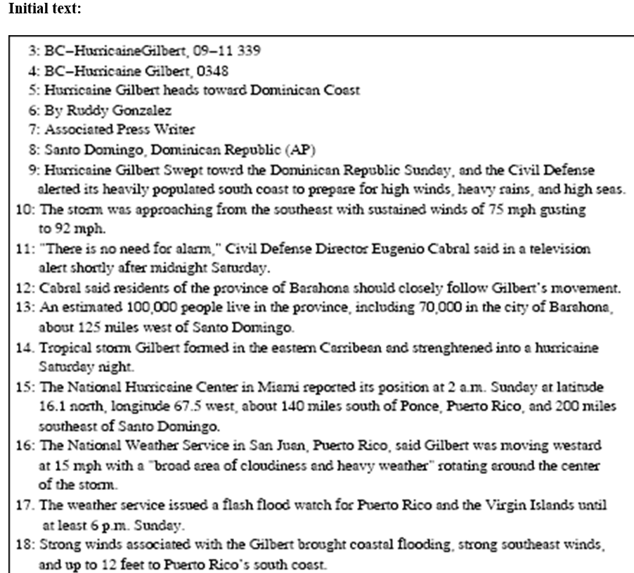

Slide 32
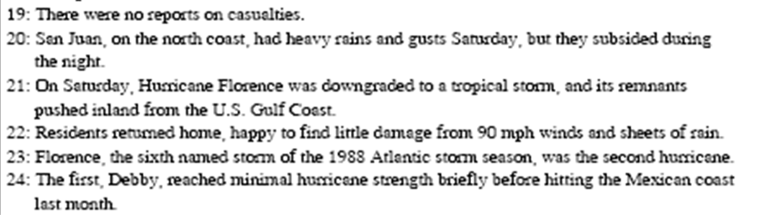
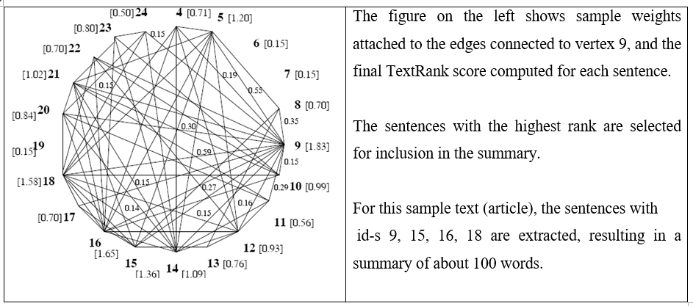

Slide 33
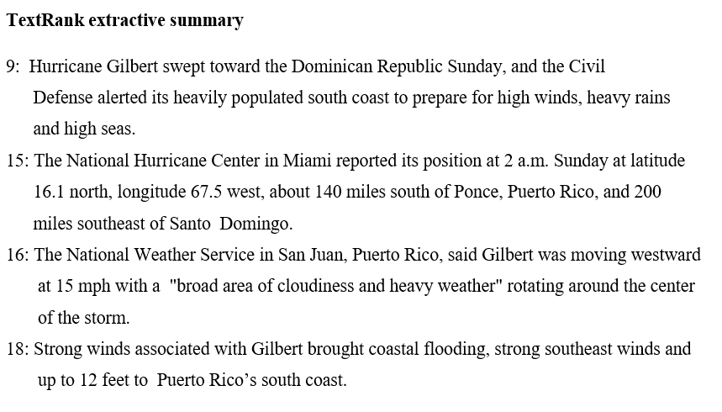

Slide 34
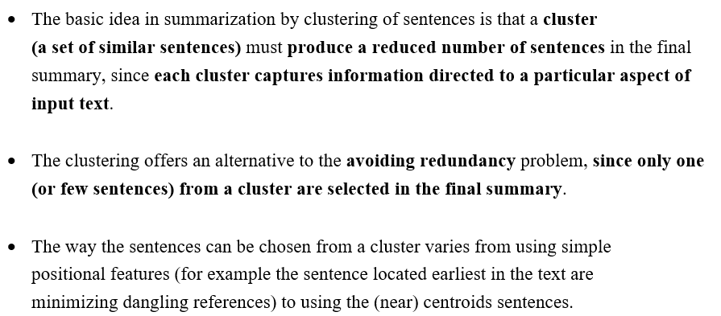
II Summarization by clustering – single document summarization

Slide 35
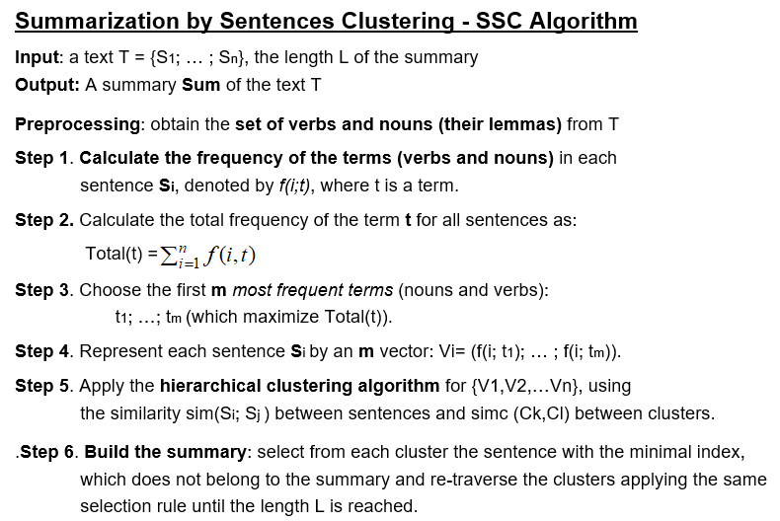

Slide 36
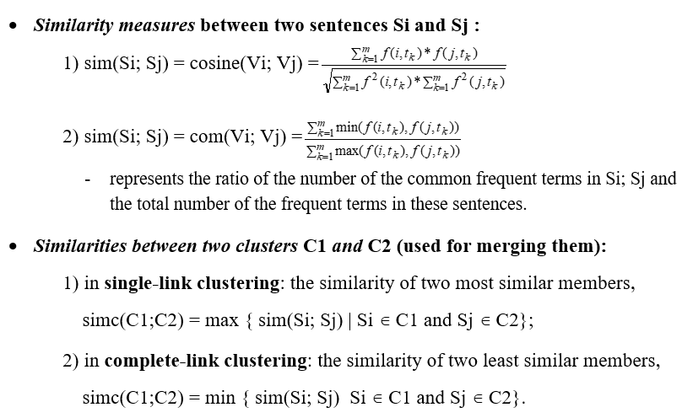
Clustering - Similarity measures

Slide 37
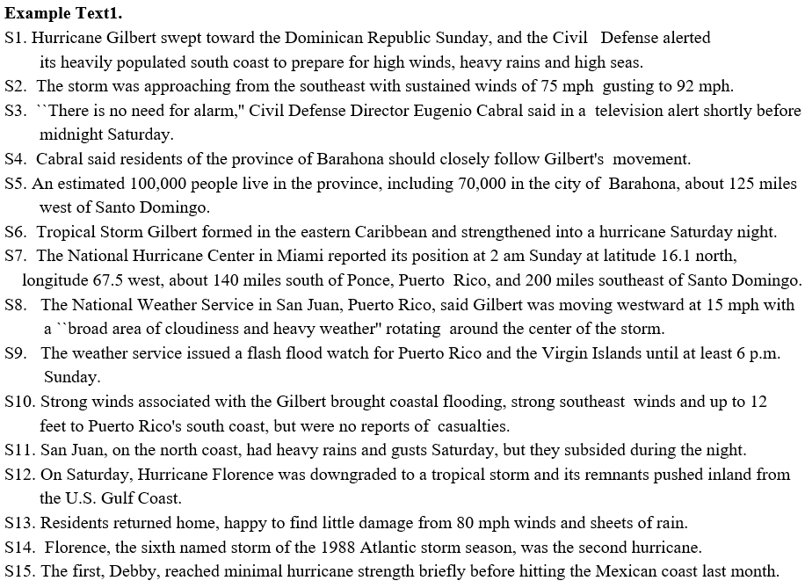

Slide 38
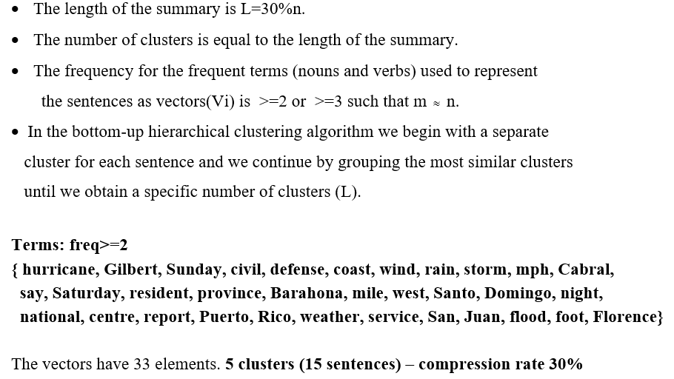
SSC- applied to Text1

Slide 39
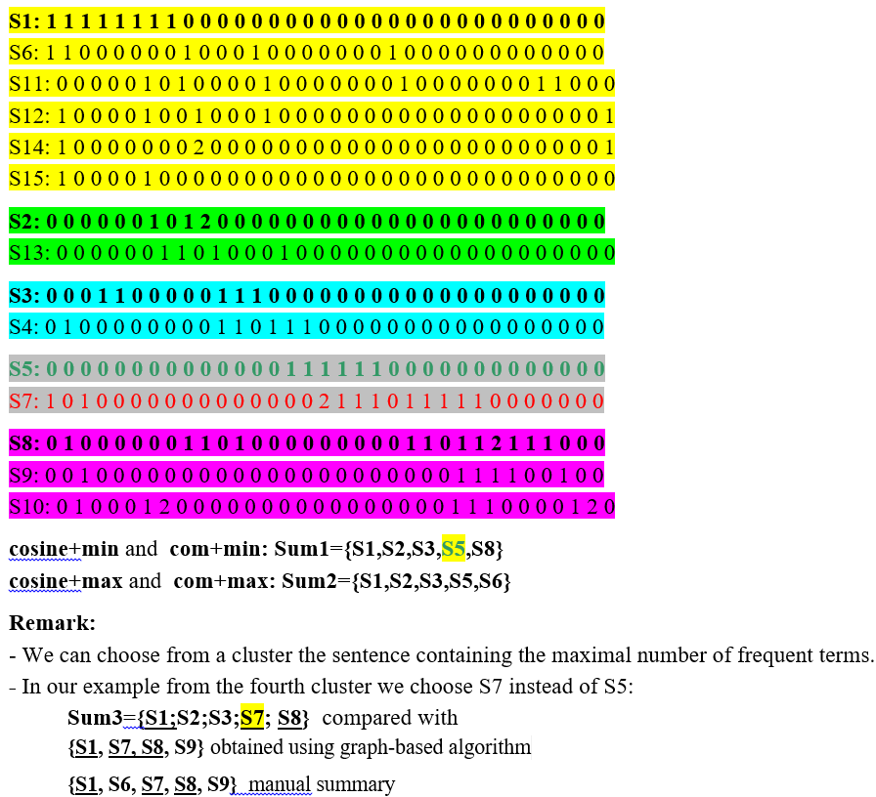
Text1-Results

Slide 40
Online summarizers
https://quillbot.com/summarize
https://www.textcompactor.com/
https://www.tools4noobs.com/summarize/

Slide 41
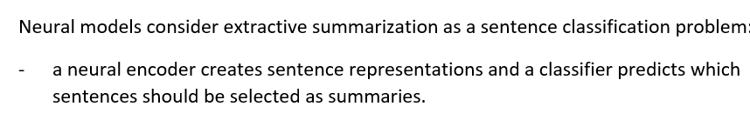
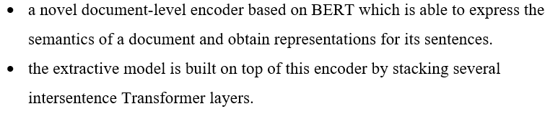
BERTSUM - Extractive summarization using BERT-
BERTSUM

Slide 42
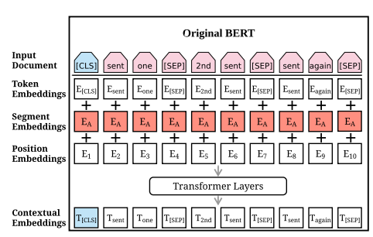
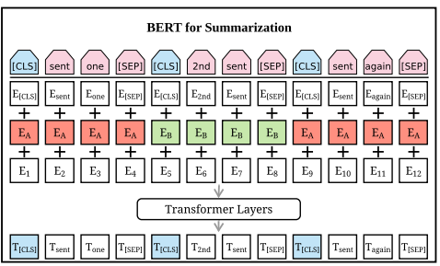
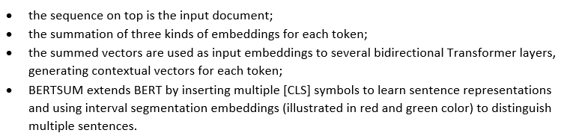
BERTSUM

Slide 43
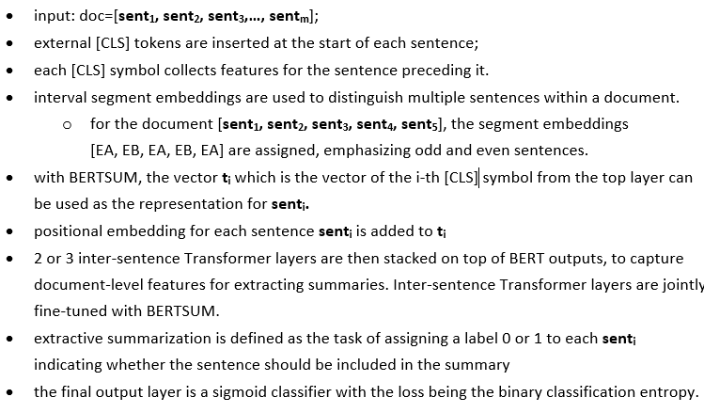
BERTSum - description

Slide 44
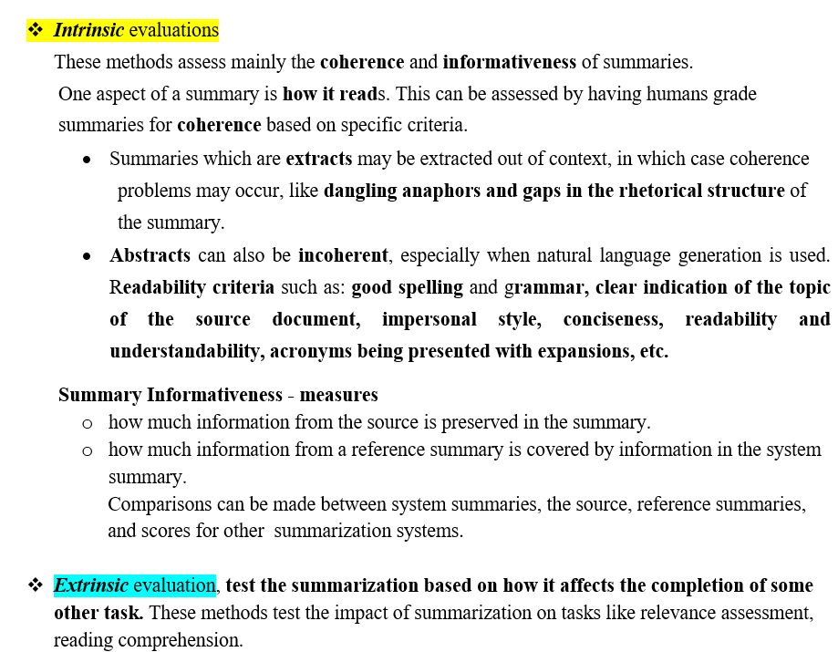
Methods for evaluating text summarization

Slide 45
